Slide 1






Angular Fundamentals
Course Overview,
Trainers, Evaluation
Angular
Development
SoftUni Team
Technical Trainers
Software University
http://softuni.bg

Slide 2


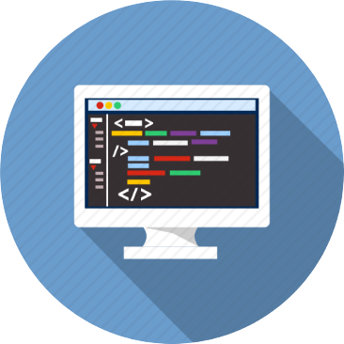
Table of Contents
Course Objectives
Course Program
Trainers Team
Course Schedule
Exams and Evaluation
Learning Resources

Slide 3
Have a Question?
sli.do #js-web

Slide 4

Angular Fundamentals
Course Objectives & Program

Slide 5


Course Objectives
The Angular Fundamentals course provides
Basic understanding of TypeScript and Angular
Covers component-based architecture
Working with remote data using RxJS
What is NOT covered?
JavaScript basics and syntax
REST communication fundamentals

Slide 6
Warning: Not for Absolute Beginners
The "Angular Fundamentals" course is NOT for absolute beginners
Take the HTML & JavaScript courses at SoftUni first: https://softuni.bg/trainings/1271/web-fundamentals-html-css-november-2015 https://softuni.bg/trainings/1295/javascript-basics-january-2016
This course is OK for beginners, but requires previous coding skills
Requirements
HTML & JS (ES 2016) coding skills – intermediate level
Computer English – entry level

Slide 7

Course Topics
Angular overview, Angular vs React, TypeScript syntax
Components, data binding, lifecycle
Observables (RxJS), DI, Services, Routing, SPA
Forms, Directives, Pipes, Animations, Interceptors
Best practices, project structure
Redux State Management (ngRx)
Workshop

Slide 8

The Trainers Team

Slide 9

Trainers Team
Ivaylo Kenov
Various job titles at the same time:
Mathematical competitions champion
Full Stack Technical Trainer
Senior Software Developer
Solutions Architect & Technical Lead
One-man army @ https://MyTestedASP.NET
{Insert Jot Title Here}
Contacts
https://github.com/ivaylokenov
https://facebook.com/ivaylo.kenov
https://linkedin.com/in/kenov

Slide 10

Trainers Team (1)
Ines Ivanova
Top student @ SoftUni
Front-end developer
Works at a startup in the area of data science
Python, C#, Angular 5, HTML, CSS, jQuery
In the free time enjoys learning C++

Slide 11

Trainers Team (2)
Kiril Kirilov
Techinal Trainer @ Software University
Involved with programming since high school
Passionate about .NET, JavaScript, Angular
Currently studying Math & Informatics at Sofia University (FMI)

Slide 12

Duration and Evaluation

Slide 13

Training Duration
Lessons: ~ 30 hours (onsite + YouTube videos)
Practical exercises (in class): ~ 30 hours
Project Defense: 20 mins
Defense Date: 26 August 2018

Slide 14

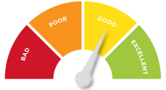
Scoring System for the Course
Project – 90%
Homework (exercises) – 10%
Bonuses: up to 10%
Presence in class: 5% (onsite students only)
Forum activities: 5%

Slide 15



Learn to Search Online
The course assignments require searching online
This is an important part of the learning process
Some exercises intentionally have no hints
Learn to find solutions!
Software development includes everyday searching and learning
No excuses, just learn to study!
Developers learn new technologies, tools, languages every day!

Slide 16

Homework Assignments
Doing your homework is very important!
Programming can only be learned through a lot of practice!
You should write code every day!
Each lesson is followed by many exercises
Try to solve them in class
The rest are your homework
Homework assignments are due 7 days after each lecture
Submission through the course page

Slide 17










Resources
What We Need Additionally?

Slide 18


Your RFID Chip
Students can either
Take RFID chip from SoftUni
Or use their own chip / card (125 KHz)
Register your chip number in your SoftUni profile: https://softuni.bg/users/profile/show
Check-in at the reception every time when you come in SoftUni
See your last visits in your profile: https://softuni.bg/users/profile/show

Slide 19



Course Web Site, Forum and FB Group
Official web site:
Official discussion forum:
Official Facebook group:
softuni.bg/trainings/2037/angular-fundamentals-july-2018
softuni.bg/forum/categories/110/angular
fb.com/groups/SoftUniJSWebMay2018

Slide 20

The Software Technologies Slides and Videos
All lecture slides, videos, homework assignments, projects and other resources are open content, available for free
Visit the course web site to access the course resources

Slide 21


Recommended Software
Node.js (Current Version)
Development Environment
Or an IDE of your choice
https://nodejs.org/en/download/
https://code.visualstudio.com/
https://jetbrains.com/webstorm/

Slide 22












Course Introduction
https://softuni.bg/courses/

Slide 23
License
This course (slides, examples, demos, videos, homework, etc.) is licensed under the "Creative Commons Attribution-NonCommercial-ShareAlike 4.0 International" license

Slide 24





Trainings @ Software University (SoftUni)
Software University – High-Quality Education, Profession and Job for Software Developers
softuni.bg
Software University Foundation
http://softuni.foundation/
Software University @ Facebook
facebook.com/SoftwareUniversity
Software University Forums
forum.softuni.bg

